Slide 1









Tetris Project
CDR - Project 5A GPSE
03/11/2021
Marchand Loïc
5A GPSE
2021-2022
Notes:
<numéro>

Slide 2
SUMMARY
Presentation of the project
Tasks
Components
Risk
Planning
Skills
Marchand Loïc
5A GPSE
2021-2022
2

Slide 3
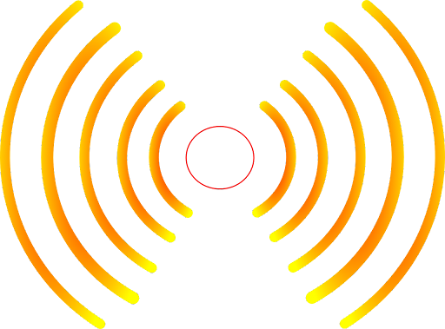
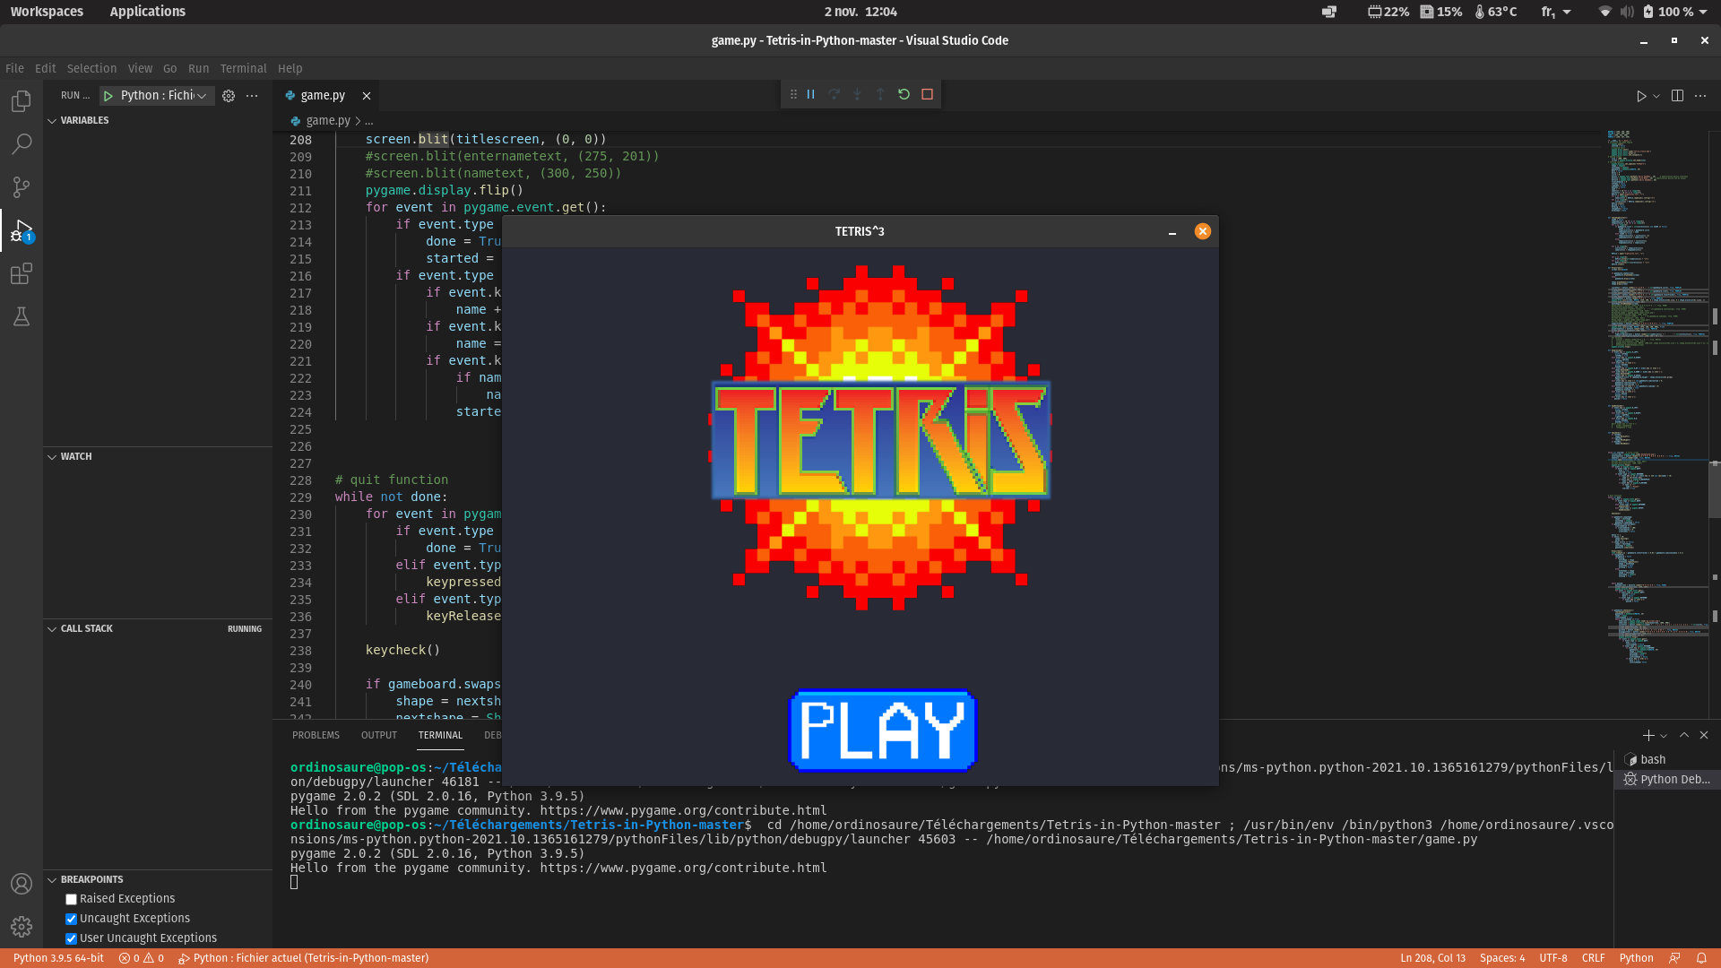

Presentation of the project
Marchand Loïc
5A GPSE
2021-2022
3

Slide 4
Presentation of the project
Weight : < 500g
Dimensions : 7cm x 7cm x 7cm (all the control cube) and 5cm x 5cm x 5cm (the electronic part of the cube)
Autonomy : 1 hour
Marchand Loïc
5A GPSE
2021-2022
4

Slide 5
Presentation of the project
Dimensions : 50cm x 50cm x 50cm
Screen : 19inches
Weight : 8kg
Marchand Loïc
5A GPSE
2021-2022
5

Slide 6

Tasks
Marchand Loïc
5A GPSE
2021-2022
6

Slide 7
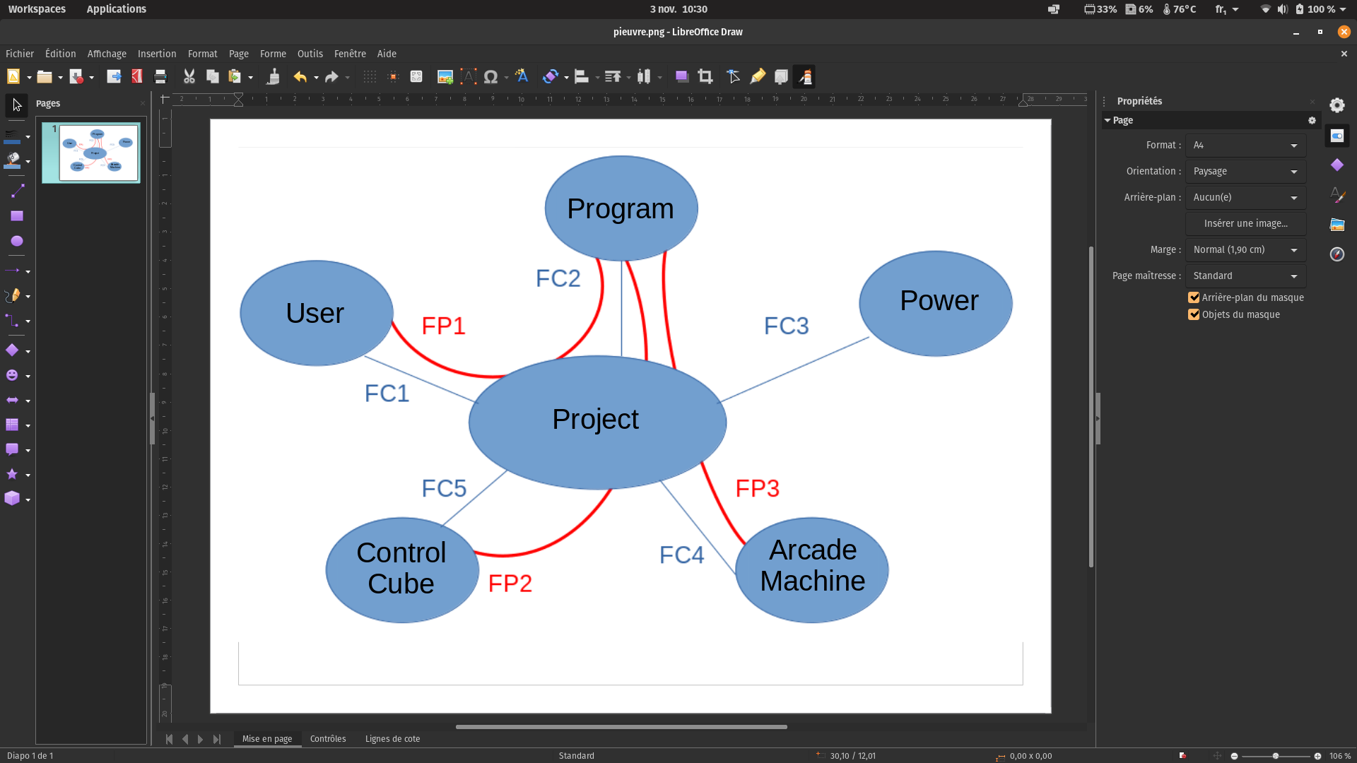
Tasks
 |  | Main function | Technical function | Criterion | Solution
PF1 |  | User can play Tetris
 | PF1.1 |  | A user-friendly interface | Usable by a 3 years old children
PF2 |  | Having a cube that allows the Tetris to be controlled remotely by movements
 | PF2.1 |  | Wireless control cube | Lenght : 2 m | Bluetooth
 | PF2.2 |  | Rechargeable | Time of use : 1h Recharge time : 30min
 | PF2.3 |  | Easy to use | Usable by a 3 years old children
 | PF2.4 |  | Be fall resistant | Height : 2m
 | PF2.5 |  | Visually attractive |  | LED and mirrors
Marchand Loïc
5A GPSE
2021-2022
7

Slide 8
Tasks
 |  | Main function | Technical function | Criterion | Solution
PF3 |  | Play Tetris on an arcade terminal
 | PF3.1 |  | Good quality | Square box : 50cm x 50cm x 50cm Screen : 18inches Weight : 8kg
 | PF3.2 |  | Interact with the game | Lighting effect
CF1 |  | Be intuitive |  | Simple control
CF2 |  | Python program must be flexible |  | Possibility of put all of the instructions we want
CF3 |  | Arcade machine works with main power |  | 230V
CF4 |  | Good quality of video an sound |  | Screen and speakers
CF5 |  | Be ergonomic |  | Weight < 500g
Marchand Loïc
5A GPSE
2021-2022
8

Slide 9
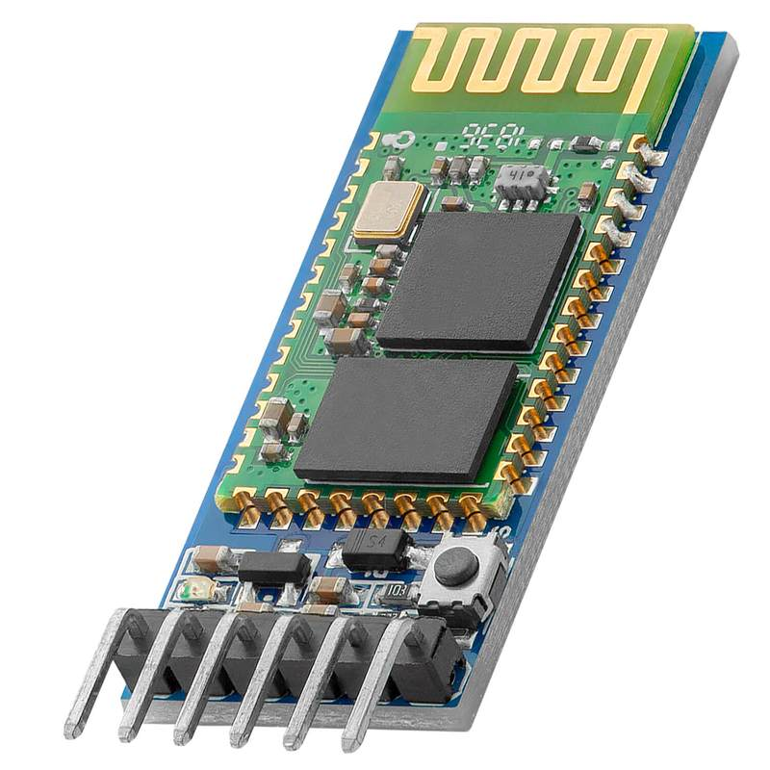
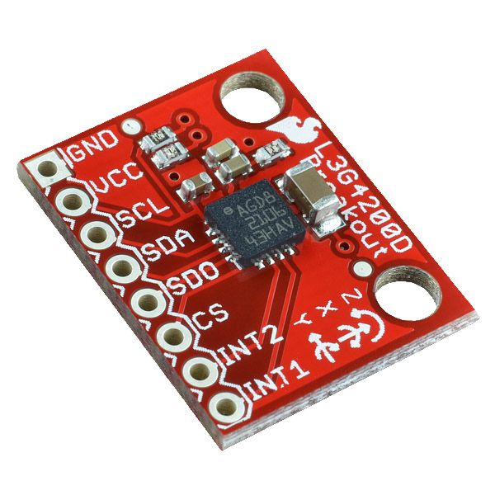
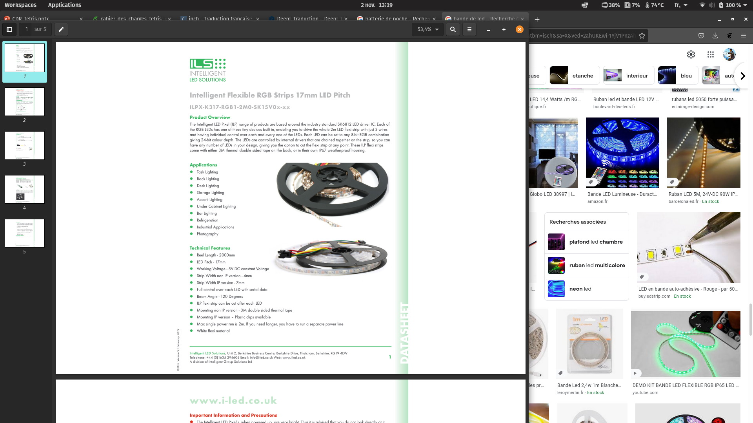
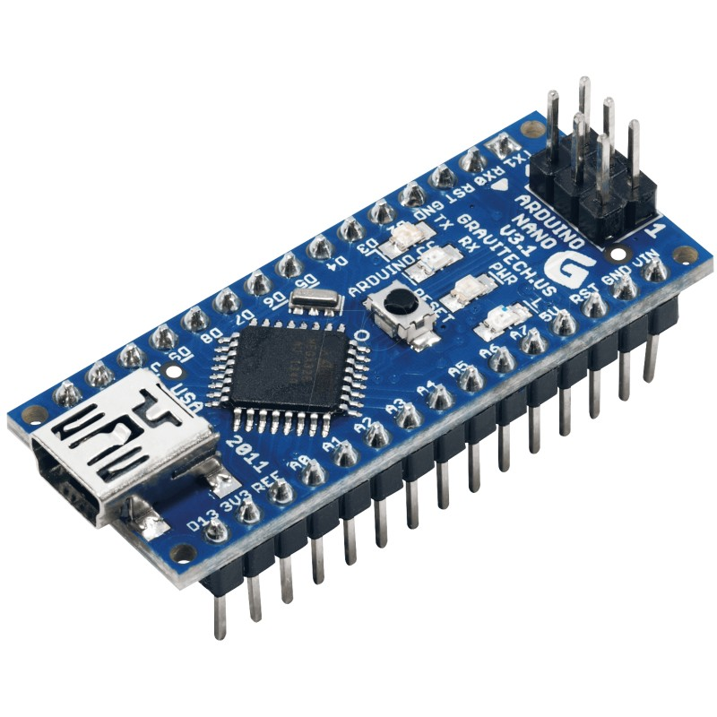
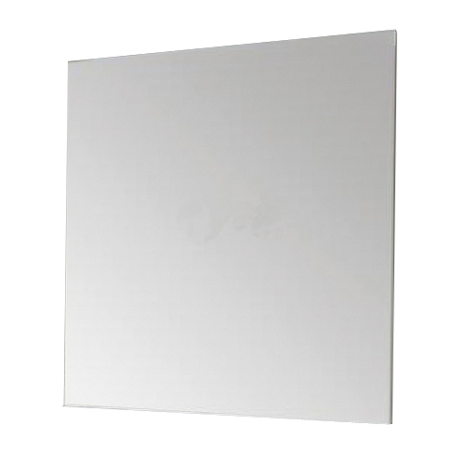
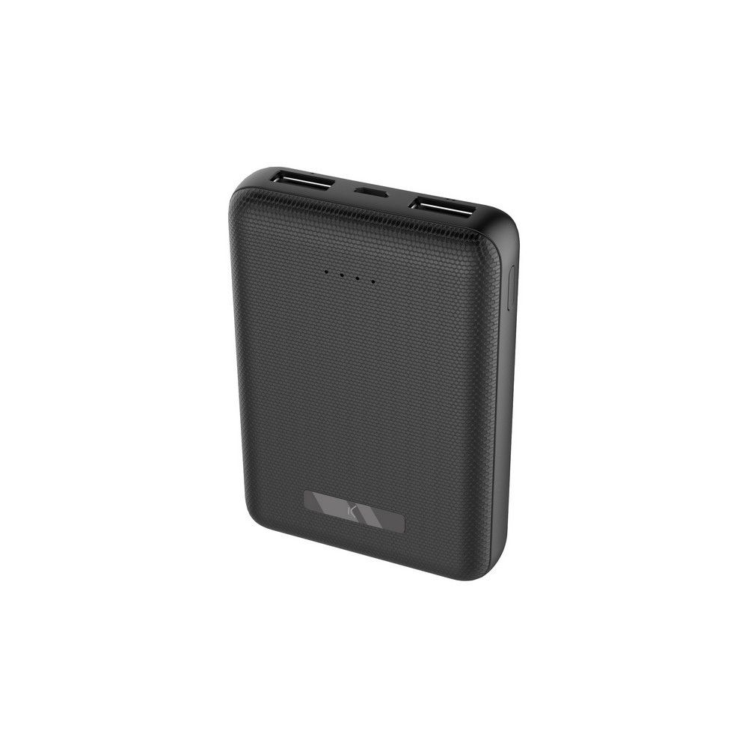
Components
Marchand Loïc
5A GPSE
2021-2022
9

Slide 10
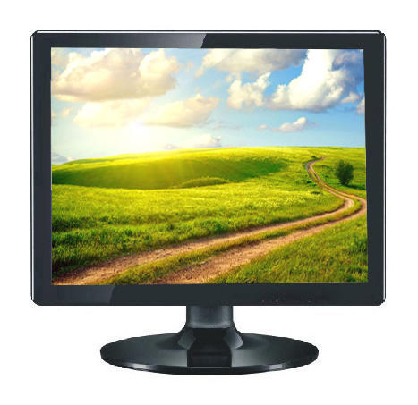
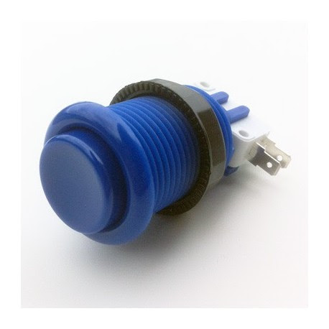
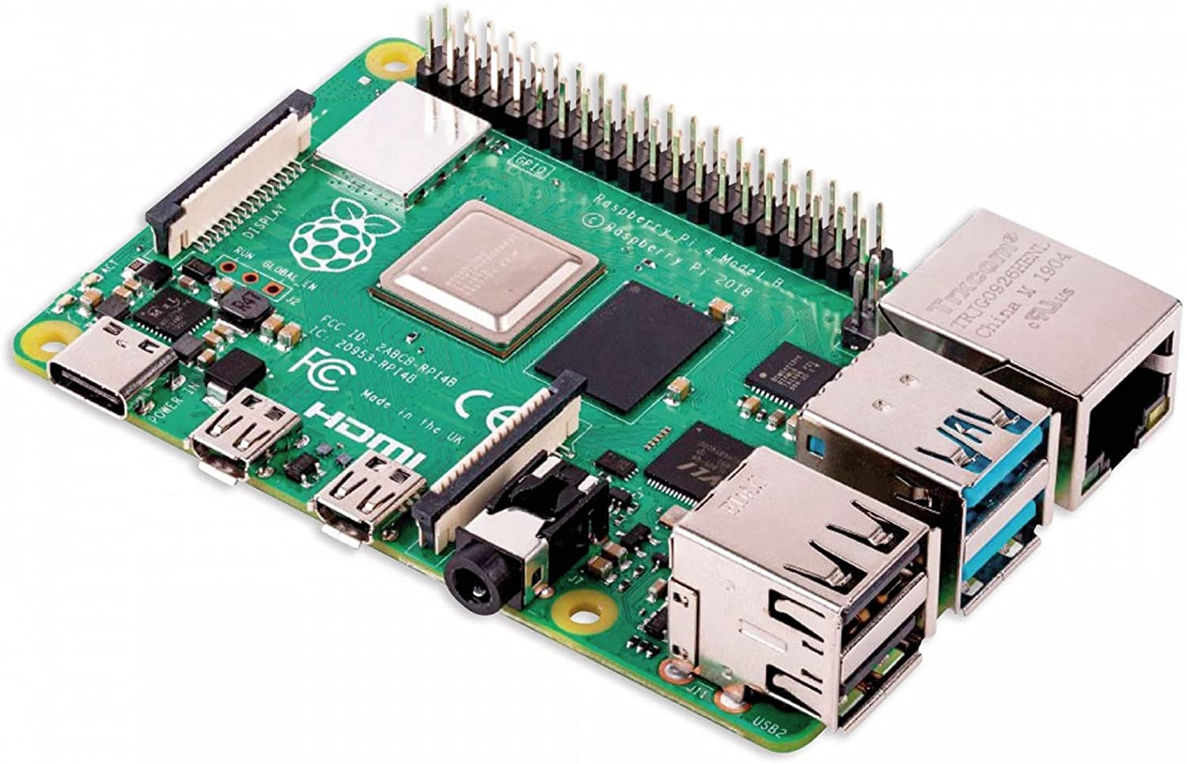
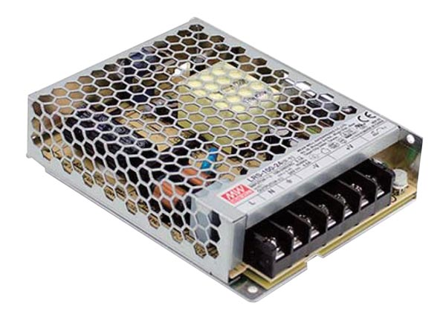
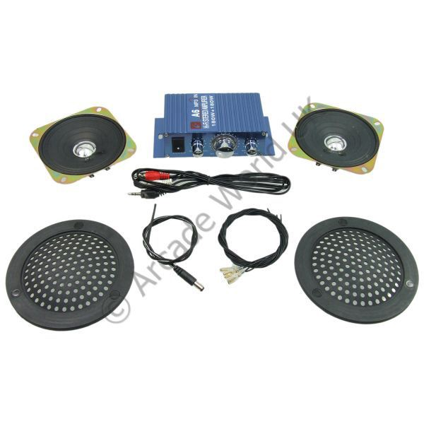
Components
Marchand Loïc
5A GPSE
2021-2022
10

Slide 11
Risk
Issue : | Frequency | Gravity | Criticaly | Action plan
Delay in components delivering | 2 | 4 | 8 | Plan tasks that do not requires component delivered
Marchand Loïc
5A GPSE
2021-2022
11

Slide 12
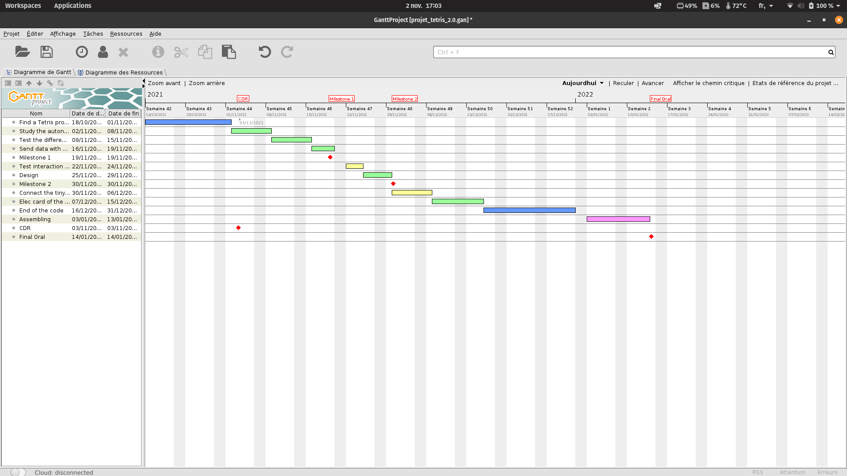
Planning
Marchand Loïc
5A GPSE
2021-2022
12

Slide 13
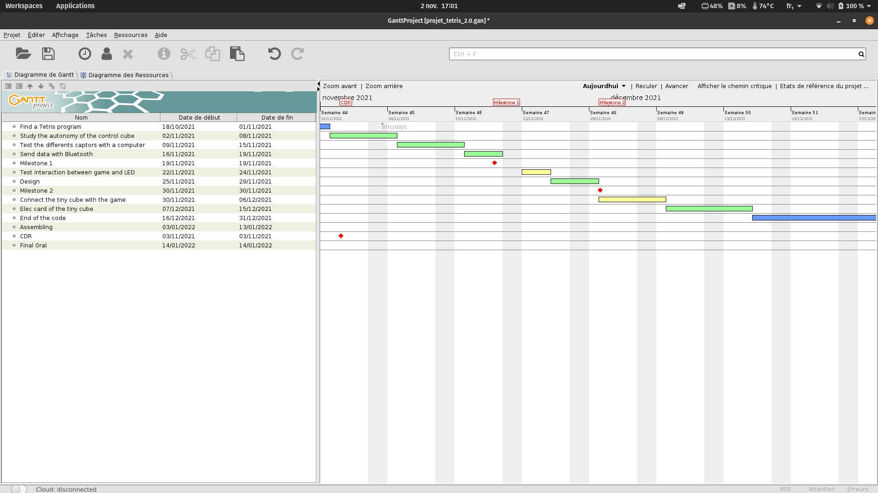
Planning
Marchand Loïc
5A GPSE
2021-2022
13

Slide 14
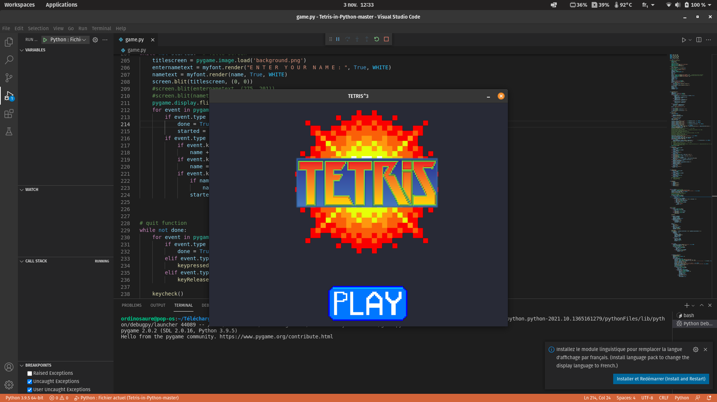
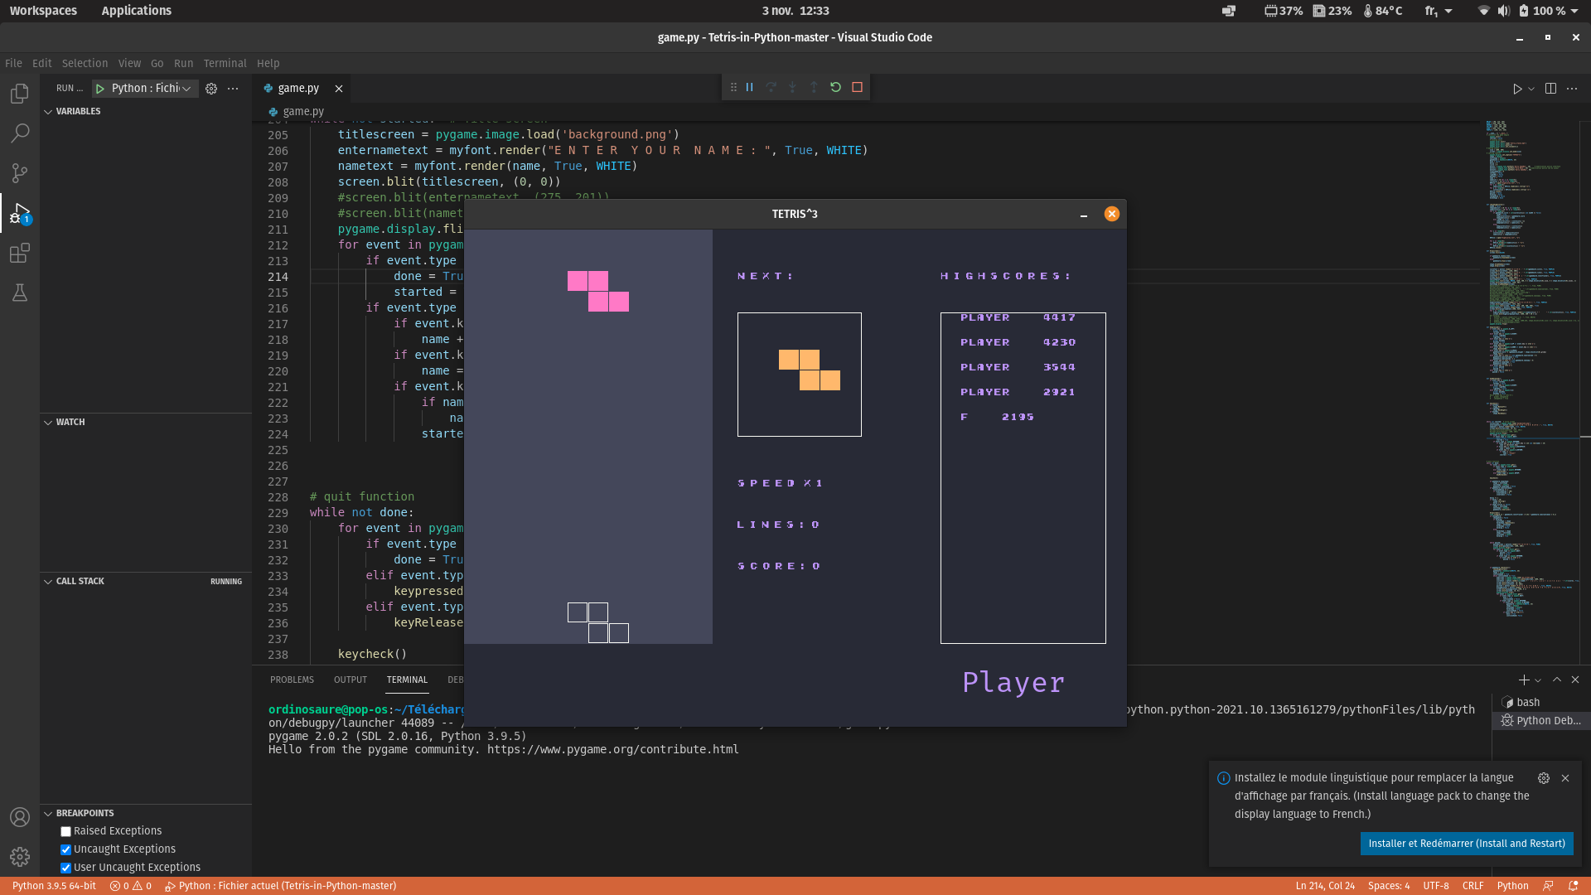
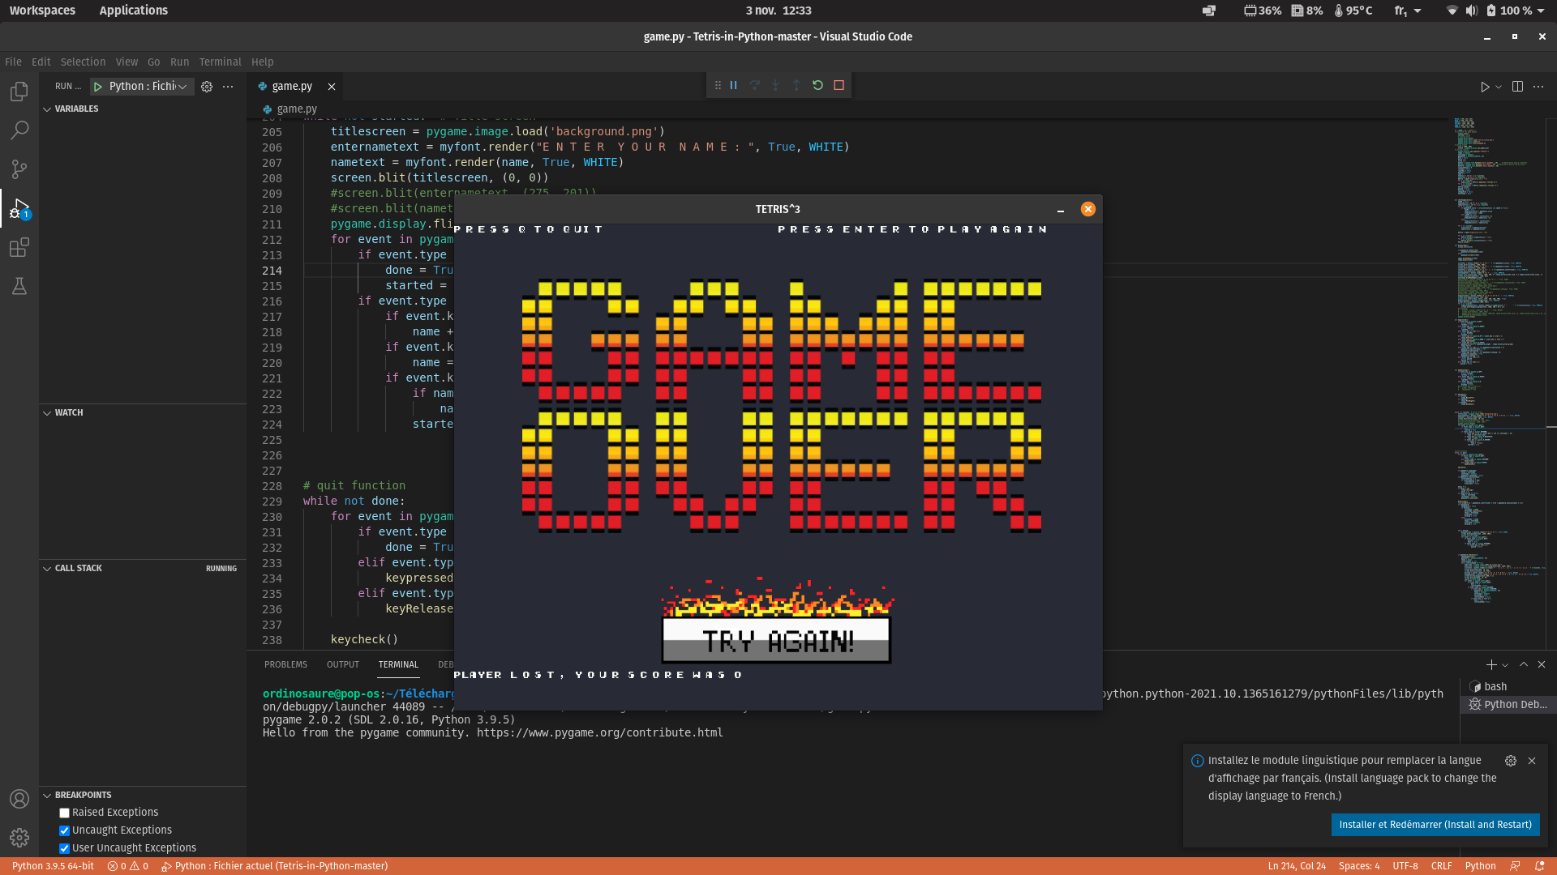
Planning
Marchand Loïc
5A GPSE
2021-2022
14

Slide 15
Skills
Learn how to manage whole a project alone
Develop my skills in programming
Improve my stress management
Marchand Loïc
5A GPSE
2021-2022
15

Slide 16
Marchand Loïc
5A GPSE
2021-2022
16

